Slide 1

Customer Billing System
- Group 11

Slide 2
Abstract
“Customer Billing System” is a simple Command-Line based billing and customer database program that can help businesses manage their customer data and assist with the billing process in a very cost and time-efficient manner. It uses C Language as the front end and Generic Data Files to store the data in the backend. This program lets the businesses store customer accounts along with their basic details and their wallet balance.

Slide 3
Introduction
This program is intended to be used by Business Managers and the Billing Team. It works by providing the user with a menu-based interface. Users can create accounts for their customers by entering basic details which are then stored in Generic Data Files which are located in the same Directory as the Program Code. The Program also offers the user the functionality to fetch the Customer Details and update their wallet balance according to the Sale Bill or Wallet Top-Up.
The whole program has been written in C-Language which is a high-level and general-purpose procedural computer programming language that supports structured programming, lexical variable scope, and recursion with a static type system.

Slide 4
Objective
This program aims to solve the problem of long billing queues at the checkout counter and ease out the customer details and bill management process for all types of businesses all while increasing time efficiency and reducing human error which can result in huge losses for high-value transaction businesses.

Slide 5
System Requirement
Software Requirements:
Language Used: C (C18)
Hardware Requirements:
Operating System: Windows 7 or Later
Processor: Dual-Core and Above
RAM: 1GB or More

Slide 6
System Design

Slide 7
Algorithm
MENU: This contains all the options that can be carried out by the program
OPTION: Option Number according to the menu
NAME: Name of the Customer entered by the user
BALANCE: Money Available in Customer’s Account
Step 1: START
Step 2: Print MENU
Step 3: Input OPTION
Step 4: IF OPTION==1:
Input Customer Details
Dump customer details in NAME.dat file
Print “Details of NAME Saved Successfully”
GOTO Step 2

Slide 8
Algorithm
Step 8: IF OPTION==5:
Print “Program Terminated”
STOP
Step 5: IF OPTION==2:
Input Customer Name to be Searched
Search for the NAME.dat file
Output Customer Details
GOTO Step 2
Step 6: IF OPTION==3:
Input Customer Name and Bill Details
Search and Update for the NAME.dat file
Print “Updated Customer Balance: Rs. BALANCE”
GOTO Step 2
Step 7: IF OPTION==4:
Input Customer Name and Amount to be added
Search and Update the NAME.dat file
Print “Updated Customer Balance: Rs. BALANCE”
GOTO Step 2

Slide 9
Block Diagram

Slide 10
Start
Display MENU OPTIONS
IF MENU OPTION = 1
IF MENU OPTION = 2
IF MENU OPTION = 3
IF MENU OPTION = 4
Input Customer Details
Input Customer Name
Input Customer Name and Bill Details
Input Customer Name and Amount
Create Customer Data File
Load Customer Details
Update Customer Data File
Update Customer Data File
Output Confirmation
Output Confirmation
Output Confirmation
Output Confirmation
Stop
Output Confirmation
IF MENU OPTION =5

Slide 11
System Implementation
The program is an amalgamation of 5 Modules that are accessed by the users using the Main Module

Slide 12
Main Module
Main Module has an infinite loop that Executes the User Command as per the value returned by the Option Module. The loop can only be exited when the Value returned by the Option Module is “5”.

Slide 13
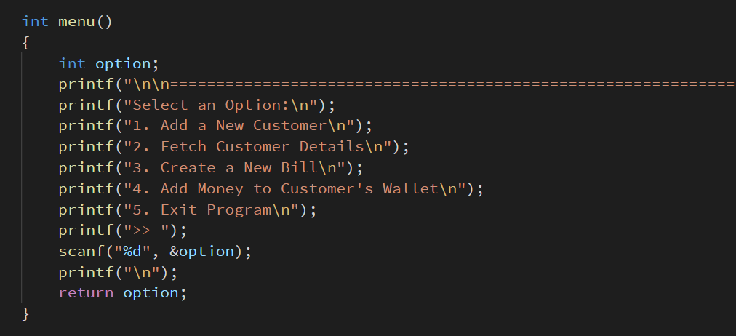
Menu Module
Menu Module prints the available functions that can be executed by the program and then inputs a number from the user which is then returned to the function call.

Slide 14
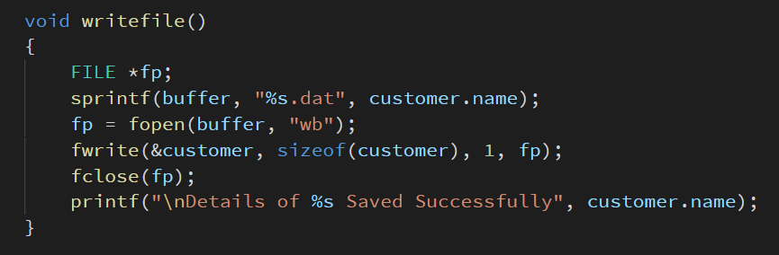
Write File Module
Write File Module dumps the Account Structure named “Customer” in a Generic Data File in the form of “CustomerName.dat” and then outputs a confirmation message.

Slide 15
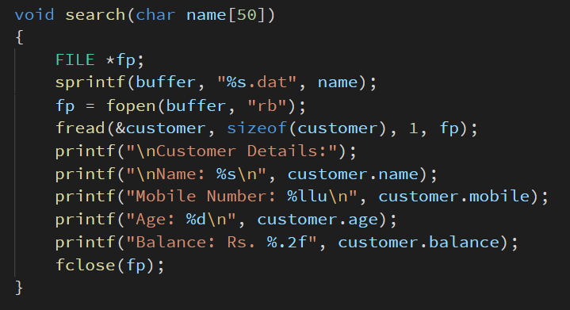
Search Module
Search Module takes Customer Name as an input and then reads the “CustomerName.dat” file after which it outputs the Customer’s Details in a Structured Format.

Slide 16
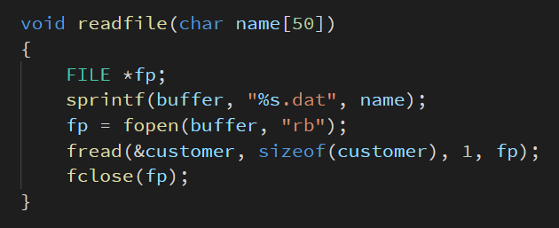
Read File Module
Read File Module takes Customer Name as an input and then reads the “CustomerName.dat” file after which it loads the read data into the Account Structure named “Customer”.

